Slide 1


Digital Skill Fair 32
Titanic Data Analysis
Presented by Kristian Tupado Naibaho
01

Slide 2

ABOUT ME
I am a statistics graduate with a strong foundation in data analysis from Brawijaya University. My expertise includes data analysis, statistical modeling, and machine learning, which I apply to derive actionable insights from complex datasets. I am passionate about using data to drive decision-making and tackle real-world problems. With excellent problem-solving and critical thinking, I am eager to embrace new challenges and continuously grow in the field. I am committed to bringing a data-driven approach to every project I undertake.
Kristian Tupado Naibaho
2

Slide 3
Table of Contents
Part 1:
Part 2:
Part 3:
Introduction
Exploratory Data Analysis (EDA)
Data Preprocessing
Part 4:
Part 5:
Part 6:
Feature Engineering
Data Modeling
Conclusion
3

Slide 4
INTRODUCTION
The sinking of the Titanic in 1912 remains one of the most notable maritime disasters in history, claiming over 1,500 lives, with a multitude of factors affecting passenger survival—such as class, gender, and age—making the analysis of this data particularly intriguing. In this project, I applied machine learning techniques to predict passenger survival from the Titanic disaster. Utilizing the popular dataset from Kaggle, the project aims to uncover the most influential factors in survival outcomes and achieve accurate predictions through data exploration, visualization, and the application of various machine learning models. This work demonstrates proficiency in leveraging machine learning to extract valuable insights from complex datasets.
4

Slide 5

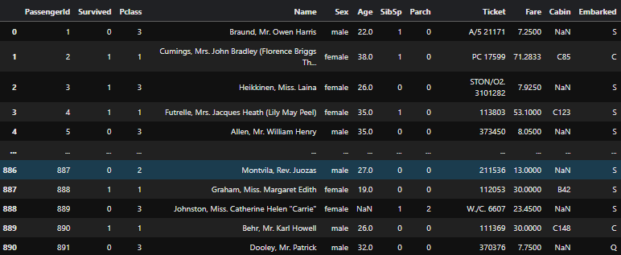
Titanic dataset
This dataset has several variables including PassengerId, Survived, Pcalss, Name, Sex, Age, SibSp, Parch, Ticket, Fare, Cabin, and Embarked.
5

Slide 6
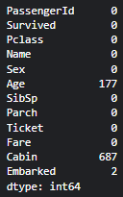
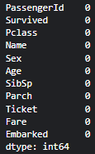
DATA PREPROCESSING
Data preprocessing for this dataset involved several steps to ensure its quality and usability. The missing values in the 'Age' variable (numerical) were filled with the median, while the missing values in the 'Embarked' variable (categorical) were replaced with the mode. Additionally, the 'Cabin' variable was dropped due to a high proportion of missing data, making it less reliable for analysis.
6

Slide 7
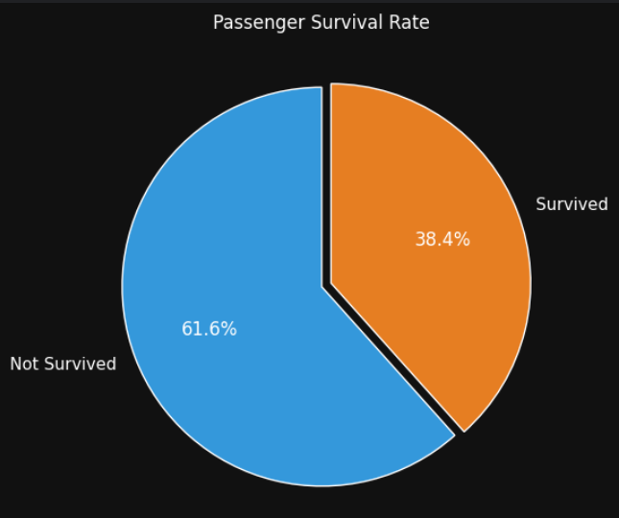
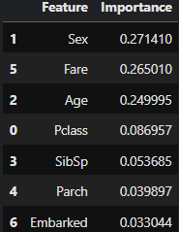
Exploratory Data Analysis (EDA)
The Pie Chart reveals that 61.6% of passengers did not survive, while the remaining 38.4% did. Key factors contributing to survival include Sex (27.1%), Fare (26.5%), and Age (25.0%), with females, higher fare passengers, and younger individuals having better chances of survival. This reflects social dynamics during the Titanic tragedy, where women and children were prioritized in rescue efforts, and higher-paying passengers had more accessible lifeboat access.
7

Slide 8
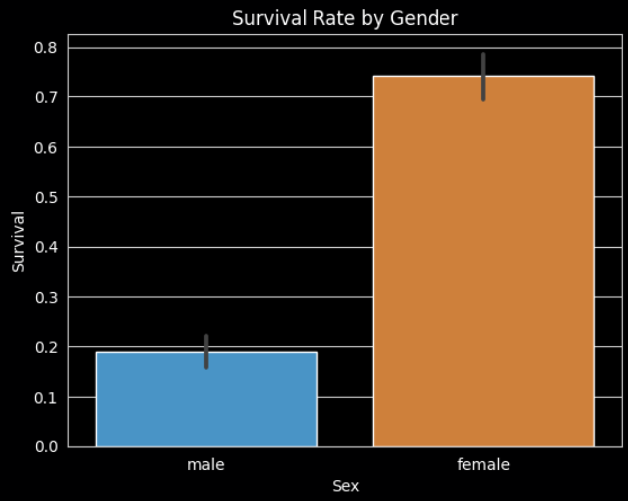
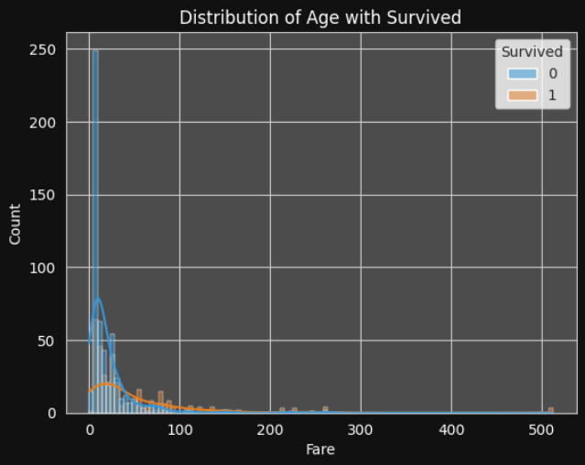
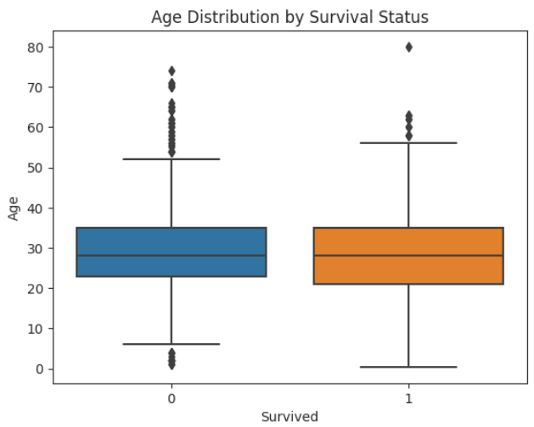
Exploratory Data Analysis (EDA)
The bar plot analysis reveals that the percentage of survivors among female passengers is considerably higher than that of male passengers. This highlights the importance of gender in survival rates during the Titanic disaster, indicating that women had a more favorable chance of survival.
The histogram illustrating that passengers with higher fare amounts were more likely to survive than those who had lower fare expenses. This trend emphasizes the correlation between fare cost and survival chance.
The boxplot shows that the ages of survivors (Survived = 1) are generally lower than those of non-survivors (Survived = 0). This suggests that younger passengers were more likely to survive, possibly because children were prioritized for rescue.
8

Slide 9
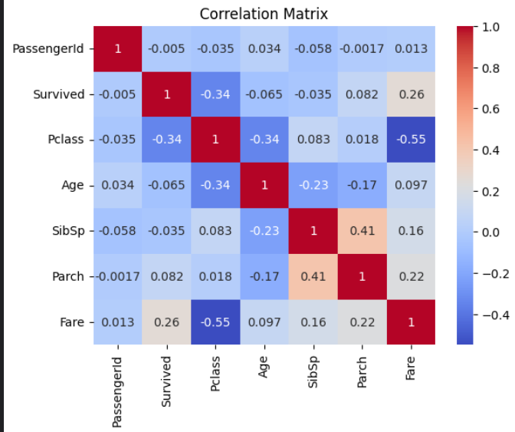
Exploratory Data Analysis (EDA)
Your Agency or Department Name
This correlation matrix shows that:
Survival is positively correlated with Fare (0.26), suggesting higher ticket prices are associated with higher survival chances, and negatively correlated with Pclass (-0.34), indicating lower class passengers had lower survival rates.
Pclass has a strong negative correlation with Fare (-0.55), meaning lower-class tickets tend to be cheaper.
SibSp and Parch are moderately correlated (0.41), indicating that passengers traveling with siblings/spouses often traveled with parents/children as well.
SDG Progress Report 2025
9

Slide 10
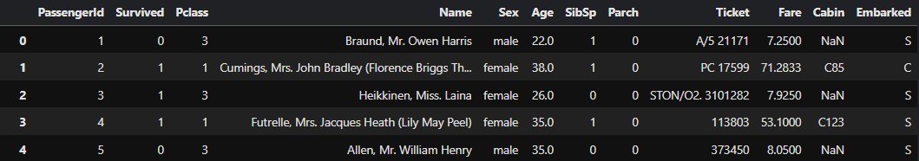

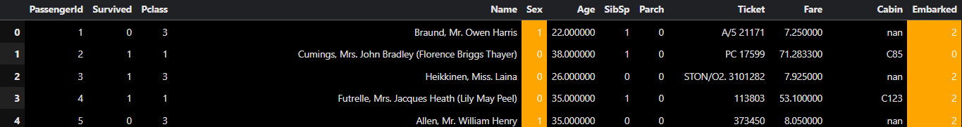
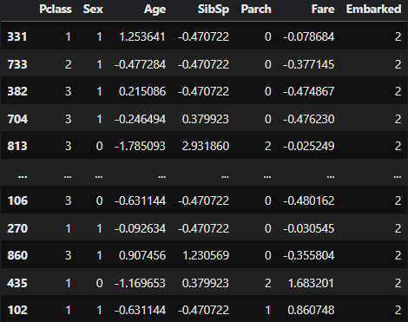
FEATURE ENGINEERING
Label Encoder is used to convert categorical data into numeric data types. For example, it converts the variable “Gender” to 0 for “Female” and 1 for “Male,” and it assigns numbers to each category in the “Embarked” variable based on the embarkation ports.
Standardization/Scaling is performed for models like KNN and XGBoost to ensure that all features contribute equally to the distance calculations and model performance.
10

Slide 11
RANDOM FOREST
DECISION TREE
Random Forest is an ensemble learning method that constructs multiple decision trees during training and outputs the mode of their predictions for classification tasks. It reduces the risk of overfitting and improves accuracy by averaging the results from many trees, making it robust to noise and variance in the data.
A Decision Tree is a model that makes decisions based on a series of questions about the features of the data. It splits the data into branches based on the answers to these questions, leading to a final prediction at the leaves.
K-NEAREST NEIGHBORS (KNN)
XGBOOST
KNN is a classification algorithm that determines the category of a data point based on the classes of its nearest neighbors in the feature space. It looks at a specified number (k) of closest data points and assigns the majority class among them to the new point.
XGBoost (Extreme Gradient Boosting) is a powerful machine learning algorithm that builds an ensemble of decision trees through a boosting process. It combines the predictions of several weak models to produce a strong model, optimizing for both speed and accuracy.
DATA MODELING
11

Slide 12
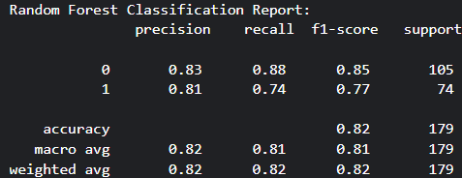
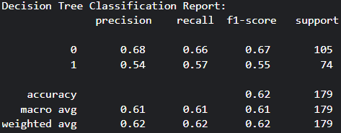
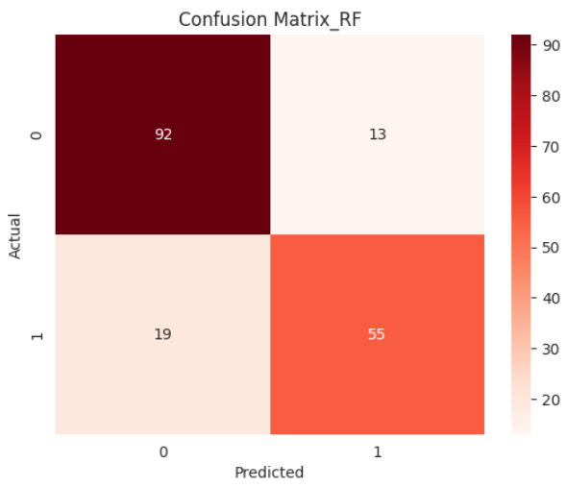
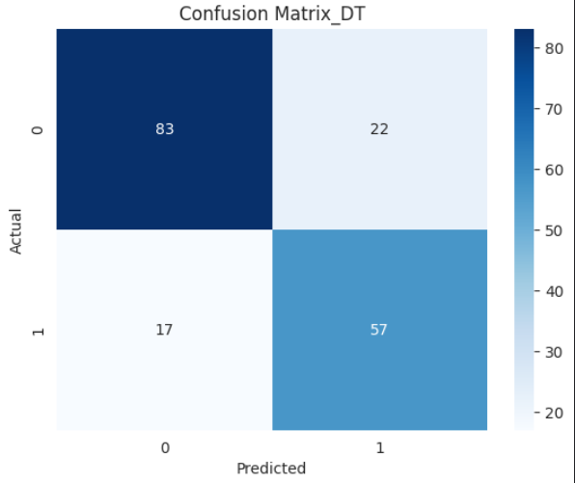
Model Accuracy
RANDOM FOREST
DECISION TREE
12

Slide 13
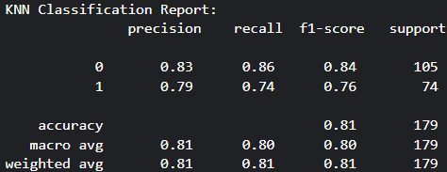
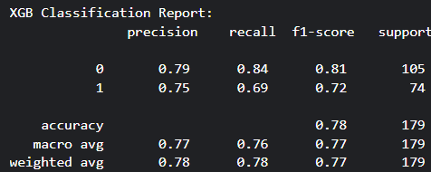
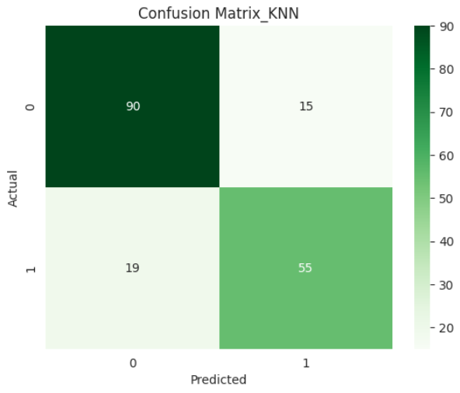
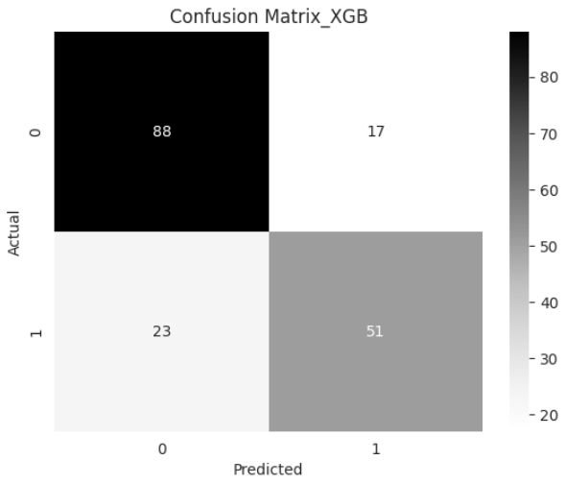
Model Accuracy
K-NEAREST NEIGHBOR
XGBOOST
13

Slide 14
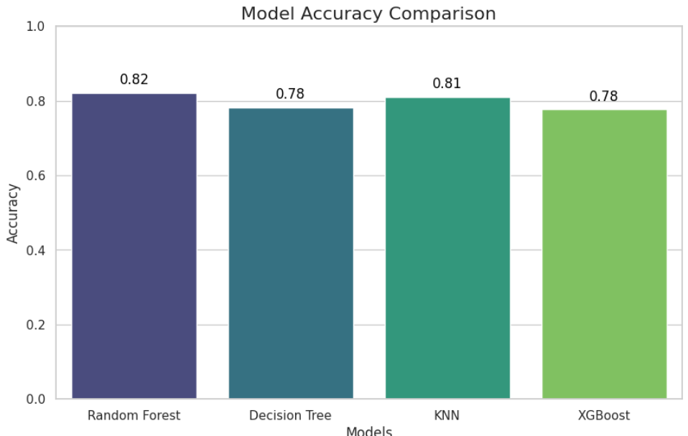
Model Accuracy Comparison
The classification reports for the four models—Random Forest, Decision Tree, KNN, and XGBoost—show varying performance in predicting survival:
Random Forest achieved the highest accuracy at 82%, with strong precision and recall for both classes.
KNN followed closely with an 81% accuracy, demonstrating solid performance in predicting both classes.
Decision Tree showed moderate results, with a lower accuracy of 78%, particularly in predicting class 1 (survived).
XGBoost also recorded an accuracy of 78%, but its precision and recall were slightly lower compared to the other models.
Overall, Random Forest stands out as the most effective model for this dataset, while the others performed reasonably well but with some limitations
14

Slide 15
CONCLUSION
This project uses machine learning to predict passenger survival on the Titanic, examining features like age, sex, class, and fare. Machine learning enables to identify complex patterns within large datasets, making it especially useful in predicting outcomes and understanding survival factors in historical events. The Titanic disaster of 1912, which led to over 1,500 fatalities, serves as a case study for exploring these patterns. Models such as Random Forest, Decision Tree, K-Nearest Neighbors (KNN), and XGBoost revealed that higher fares and specific demographics, especially women and children, were more likely to survive. The Random Forest model achieved the highest accuracy at 82%, demonstrating the value of machine learning in discovering insights into social dynamics during emergencies and offering a data-driven approach to enhance safety in future scenarios.
15

Slide 16

THANK YOU

